Slide 1
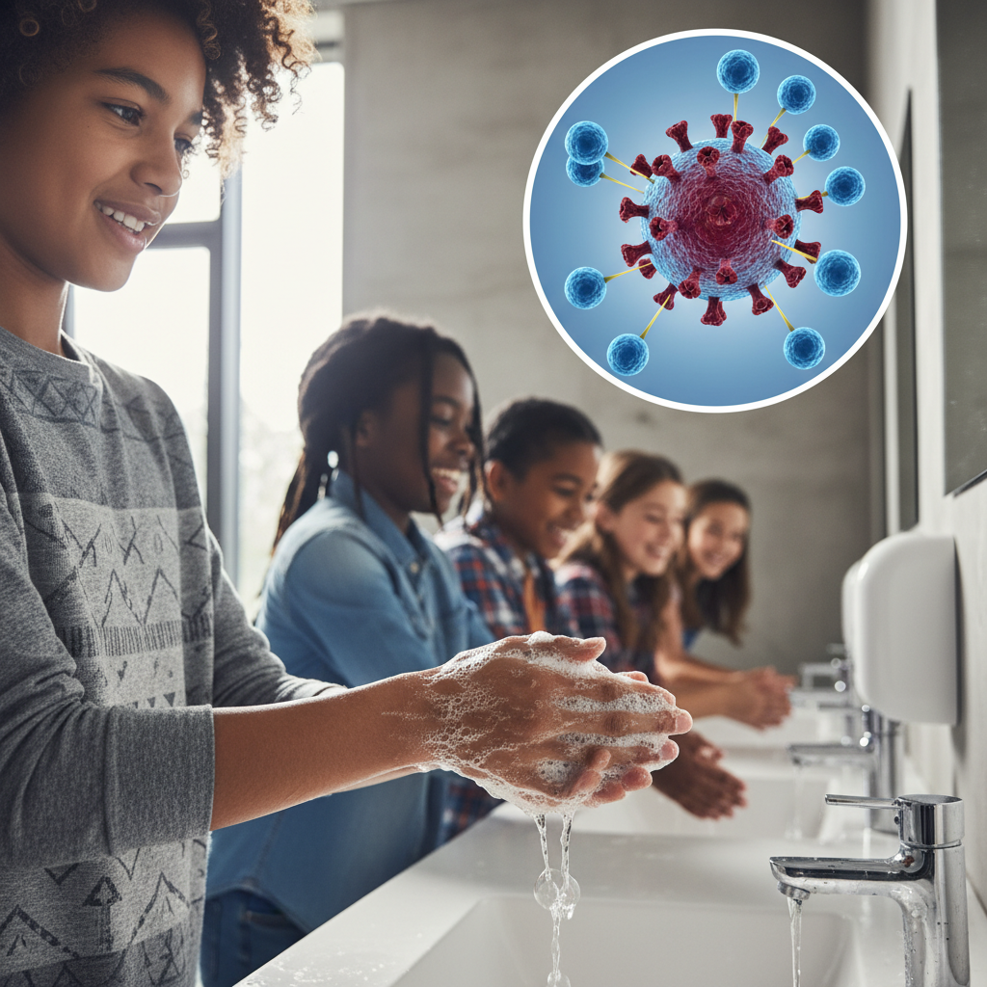
ModelIt!
Student Lesson
How Soap Actually Destroys Viruses
The Chemical Reaction That Saves Millions of Lives Every Year
NGSS: 5-PS1-4
5th Grade
1/9

Slide 2
What You Will Learn Today
Learning Goals
* Explain that soap destroys viruses through chemical interaction, not just rinsing
* Model how soap concentration and water determine effectiveness
* Trace how soap effectiveness leads to virus membrane disruption
* Apply the model to explain why proper handwashing technique matters
Key Vocabulary
Lipid
A fat or oil molecule that makes up virus outer coatings
Membrane
A thin layer that surrounds and protects a cell or virus
Amphiphilic
A molecule attracted to both water AND oil/fat
Pathogen
Any microorganism that can cause disease
2/9

Slide 3
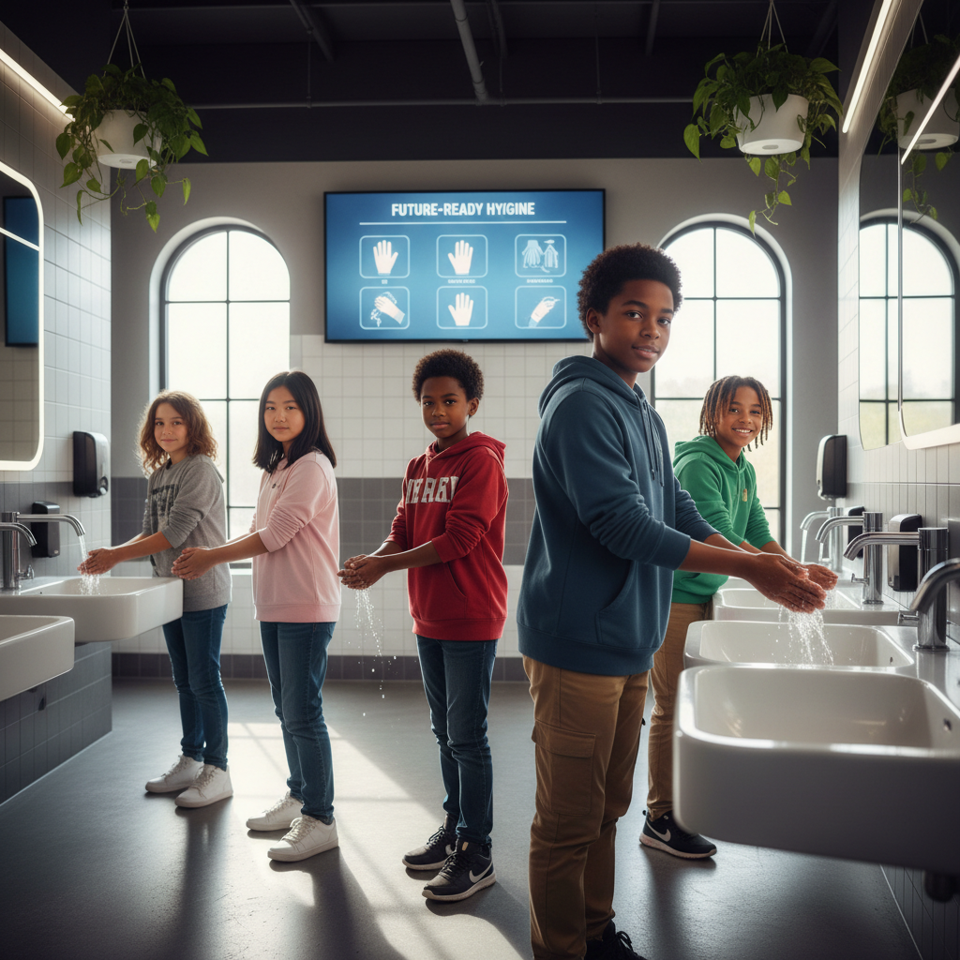
The Big Question
How does soap destroy viruses at the molecular level?
The Chemical Reaction That Saves Millions of Lives Every Year. Today we'll build a MODEL to discover the answer!
3/9

Slide 4
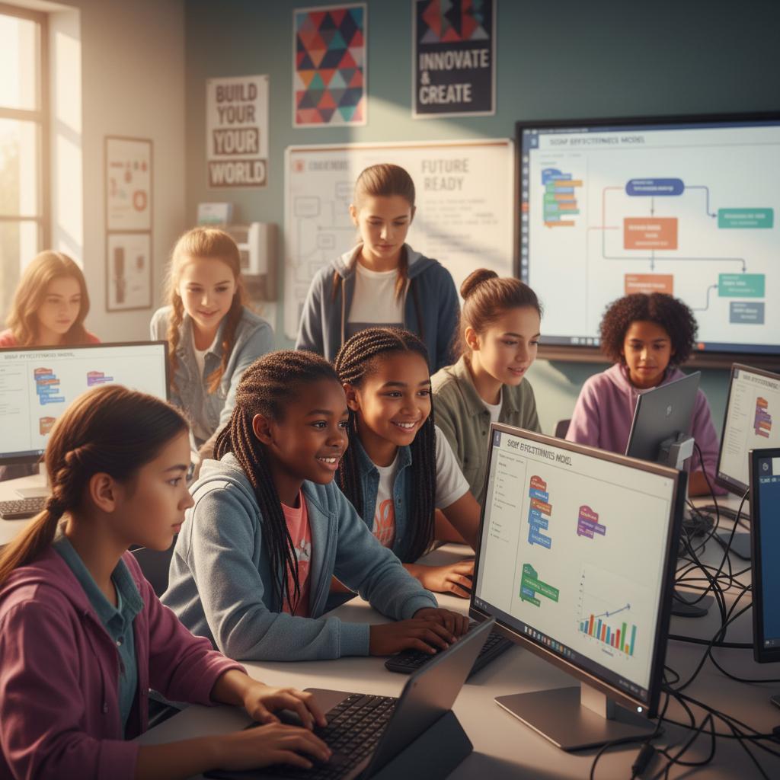
Today We Will Build a Model!
A model helps us understand complex systems!
1. LOCATE
Identify the COMPONENTS (parts) of the system
2. ESTABLISH
Connect them with RELATIONSHIPS (+ or -)
3. VISUALIZE
Build your model in ModelIt!
4. EVALUATE
Run SIMULATIONS to test scenarios
5. REVISE
Improve your model based on evidence
4/9

Slide 5
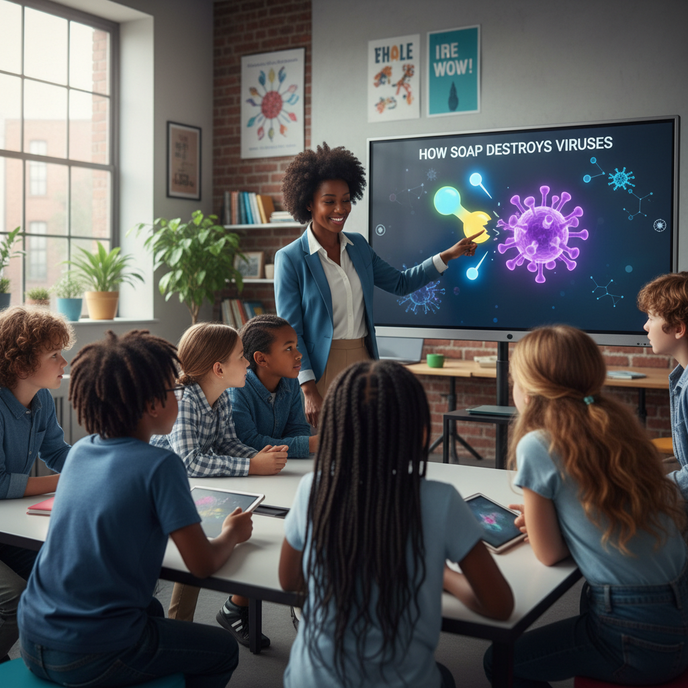
Activity 1: Sort the Components
Sort these components into EXTERNAL (inputs from outside) and INTERNAL (inside the system):
Your Components:
* Soap Concentration
* Water Present
* Soap Effectiveness
* Virus Survival Rate
Think: Which components can we control? Which happen on their own?
5/9

Slide 6
Activity 2: Connect with Arrows
Draw arrows to show HOW components affect each other:
(+) POSITIVE Relationship
When one goes UP, the other goes UP too
(-) NEGATIVE Relationship
When one goes UP, the other goes DOWN
Think About It:
Why would washing with just water be less effective than soap and water?
6/9

Slide 7
Activity 3: Run the Simulation!
Test these scenarios in ModelIt!
Water Only
Soap at 0%, Water at 100%
Dry Soap
Soap at 100%, Water at 0%
Proper Handwashing
Both Soap and Water at high levels
Watch the activity graphs change!
[ModelIt Platform Screenshot - Simulation Results Graph]
7/9

Slide 8
What Did We Discover?
Our Model Showed Us:
* Soap DESTROYS viruses by breaking apart their lipid membranes
* Water alone can't disrupt the virus's protective coating
* Soap needs water to spread and work effectively
* This is why 20 seconds of proper handwashing matters
Answer: Soap molecules have one end that loves water and one end that loves fat. They wedge into the virus's fatty membrane and break it apart - destroying the virus!
8/9

Slide 9
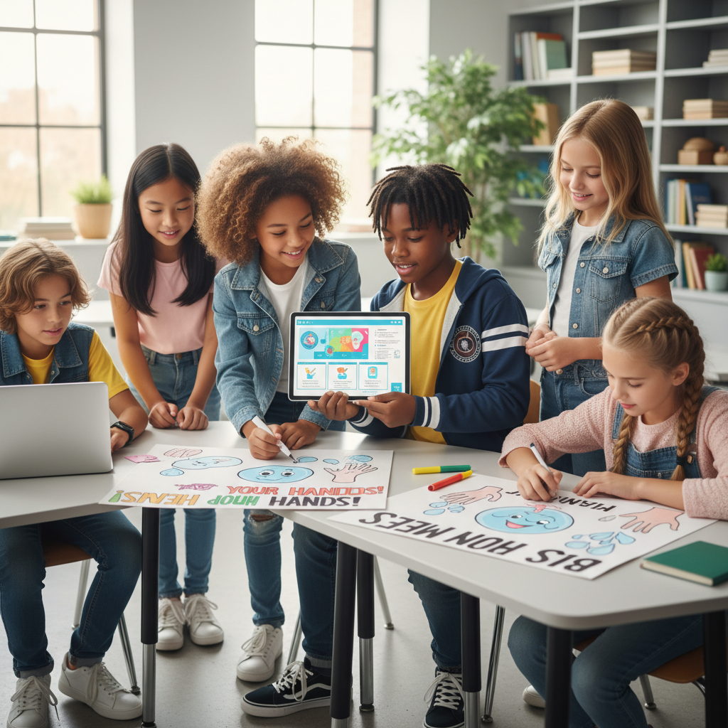
STEM Challenge: Design a Handwashing Campaign
YOUR ENGINEERING MISSION
Design a school campaign to improve handwashing and reduce illness.
The Challenge:
Your school has had several flu outbreaks. Design a science-based campaign to teach effective handwashing.
Think Like an Engineer:
* What's the minimum time needed for soap to work?
* Which areas of hands are most often missed?
* How would you convince people to wash properly?
REAL CAREER CONNECTION: Public Health Scientists and Virologists study how diseases spread and how to stop them. They earn $70,000-$115,000/year. The skills you're using TODAY are the same ones they use on the job!
9/9

